Slide 1
Introduce to qsee a package for quantum state preparation
Vu Tuan Hai, UIT-VNUHCM
25/12/2023
(Quantum group at HCM city)

Slide 2
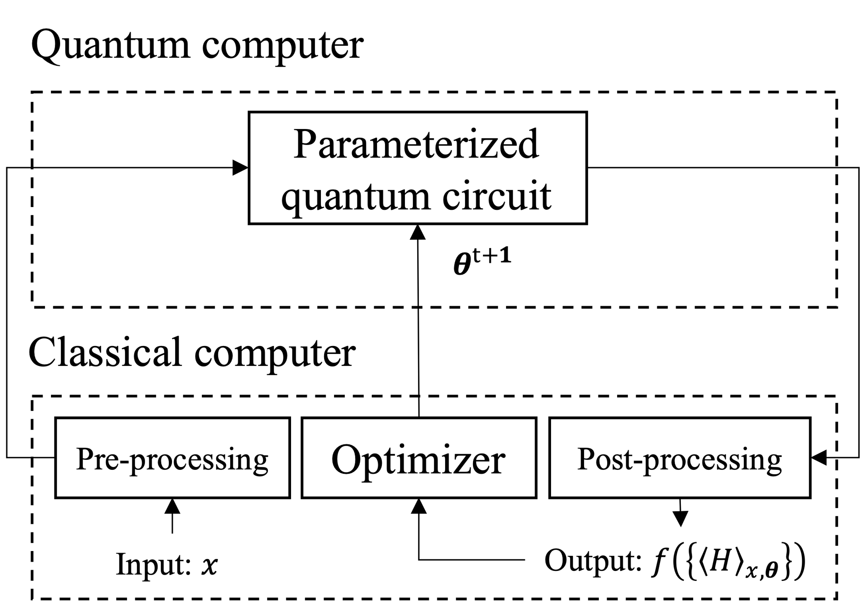


Quantum machine learning: encoding problem
Encoding desired state into quantum circuit is an important component in quantum machine learning problems.
$$⋮$$
Encoder
$$⋮$$
Fig 1. Hybrid model [1]
[1] M. Schuld and F. Petruccione, Machine learning with quantum computers (Springer, 2021).

Slide 3
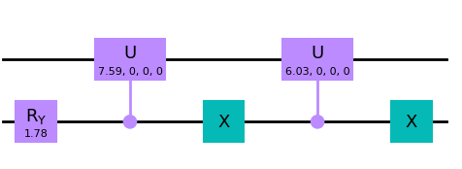
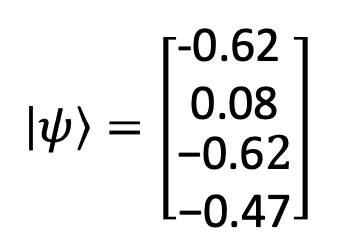
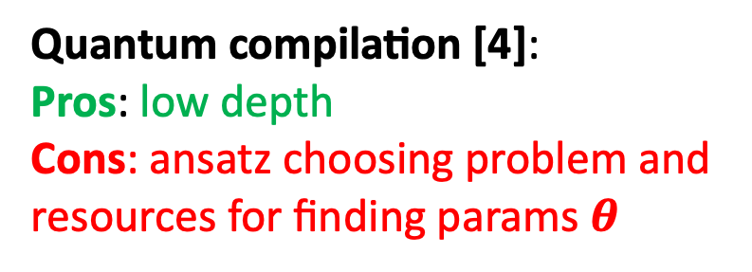
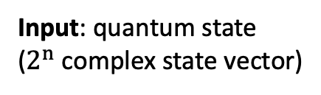
Encoding methods
$$\left|ψ\right\rangle =\left[\begin{matrix}\begin{matrix}\text{−0.62 } \\ \text{0.08}\end{matrix} \\ \begin{matrix}\text{−0.6}2 \\ \text{−0.47}\end{matrix}\end{matrix}\right]$$
Encoding methods
Input: quantum state
($2^{n}$ complex state vector)
Output: encoder
(quantum circuit)
Amplitude encoding [3]:
Pros: no-computation resources for constructing circuit
Cons: very high depth
Quantum compilation [4]:
Pros: low depth
Cons: ansatz choosing problem and resources for finding params $θ$
[3] Araujo, Israel F., et al. "A divide-and-conquer algorithm for quantum state preparation." Scientific reports 11.1 (2021): 6329.
[4] S. Khatri et al., Quantum-assisted quantum compiling, Quantum 3, 140 (2019).

Slide 4
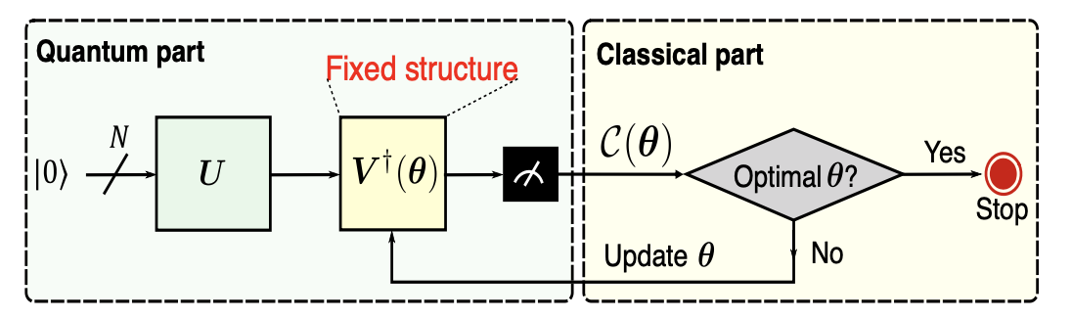
2.1. Quantum compilation [5]
Fig 2.1. A universal compilation algorithm consists of a quantum part and a classical part.
[5] Hai, V. T., & Ho, L. B. (2023). Universal compilation for quantum state tomography. Scientific Reports, 13(1), 3750

Slide 5
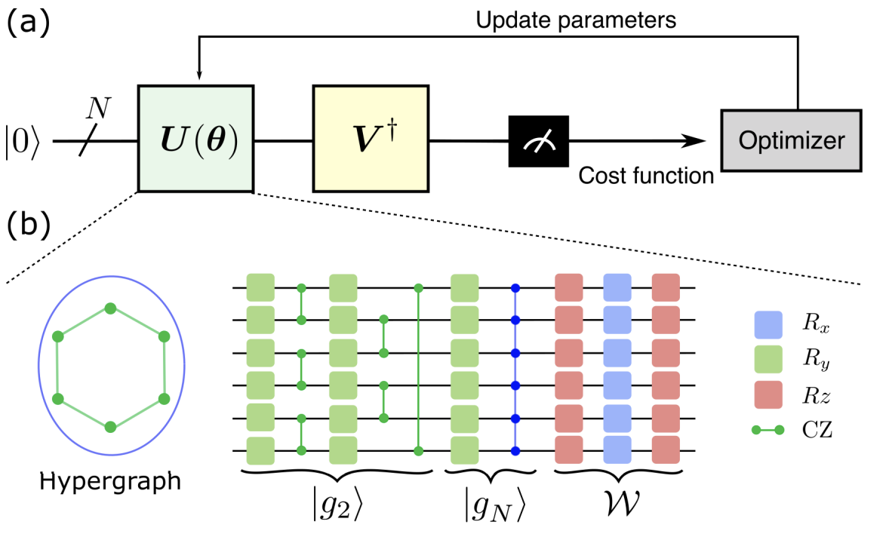
2.2. Quantum compilation: state preparation [6]
Fig 2.2. (a) Variational quantum algorithm (VQA) for quantum state preparation.
[6] Hai, V. T., Viet, N. T., & Ho, L. B. (2023). Variational preparation of entangled states on quantum computers. arXiv preprint arXiv:2306.17422.

Slide 6
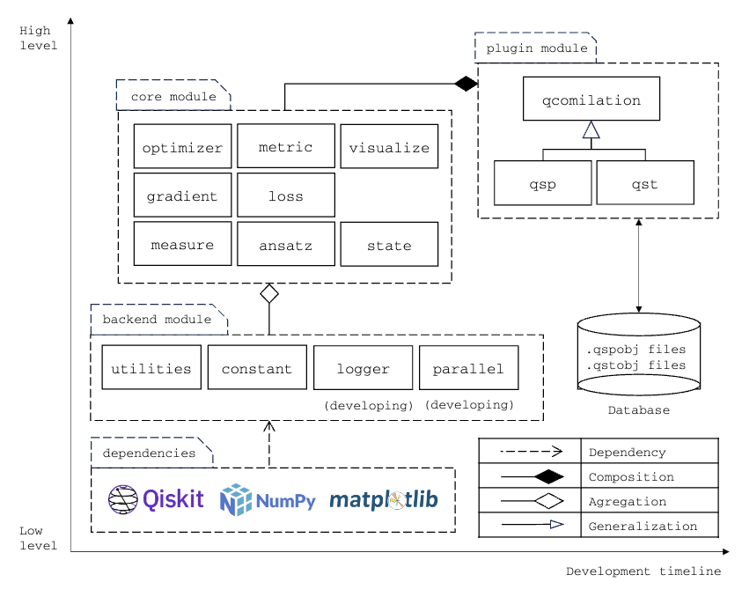
3. QSEE
QSEE is a python (qiskit – based) package for quantum compiling (quantum state preparation and tomography).

Slide 7
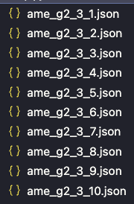
3. QSEE [7]
We have run quantum compilation for serveral case and save it as json files in a database.
Each json file has the structure like this (most valuable information is thetas)
{
"u": "g2",
"vdagger": "ame",
"num_qubits": 4,
"num_layers": 1,
"thetas": […]
}
[7] https://github.com/vutuanhai237/qsee

Slide 8


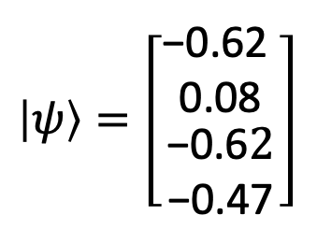


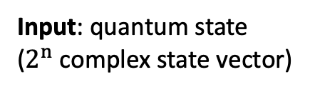
3. QSEE
$$\left|ψ\right\rangle =\left[\begin{matrix}\begin{matrix}\text{−0.62 } \\ \text{0.08}\end{matrix} \\ \begin{matrix}\text{−0.6}2 \\ \text{−0.47}\end{matrix}\end{matrix}\right]$$
Quantum compilation ($ψ$)
Initialize
$$\left\{U\left(.\right), θ\right\}$$
Input: quantum state
($2^{n}$ complex state vector)
Output: encoder
QSEE Search ($ψ$)
Database
No
Yes
If $\left|ψ\right\rangle$ exist

Slide 9
3. QSEE: Demos
from qsee.compilation import QuantumStatePreparation
target_state = [1/sqrt(2), 0, 0, 1/sqrt(2)]
encoder = QuantumStatePreparation.prepare(target_state)

